Slide 1
Introduction
Data management is a critical step in data analysis.
Stata provides powerful tools for managing and manipulating data.
This presentation overs key data management tasks in Stata

Slide 2

How to label variables
Purpose: Adds a descriptive label to a variable for better understanding
Command: label variable
Example:
label variable age "Age of Respondent"

Slide 3
CATEGORICAL VARIABLES

Slide 4
Creating code for categorical variables
Purpose: Converts a string categorical variable into a numeric variable with labelled values.
Command: encode
Example: encode gender, generate (gender_new)
This will convert string variable gender (“Male”, “Female”) into a numeric variable gender_new with labelled values (1=Male, 2=Female)

Slide 5
Labelling values of categorical variables
Purpose: Assigns meaningful labels to numeric codes for categorical variables
Command: label define and label values
Example
label define gender 1”Male” 2”Female”
label values sex gender

Slide 6

Generating new variable from existing variable
Purpose: Creates a new variable based on an expression or transformation of an existing variable
Command: generate
Example:
generate new_var = old_var
generate agenew = ageold

Slide 7
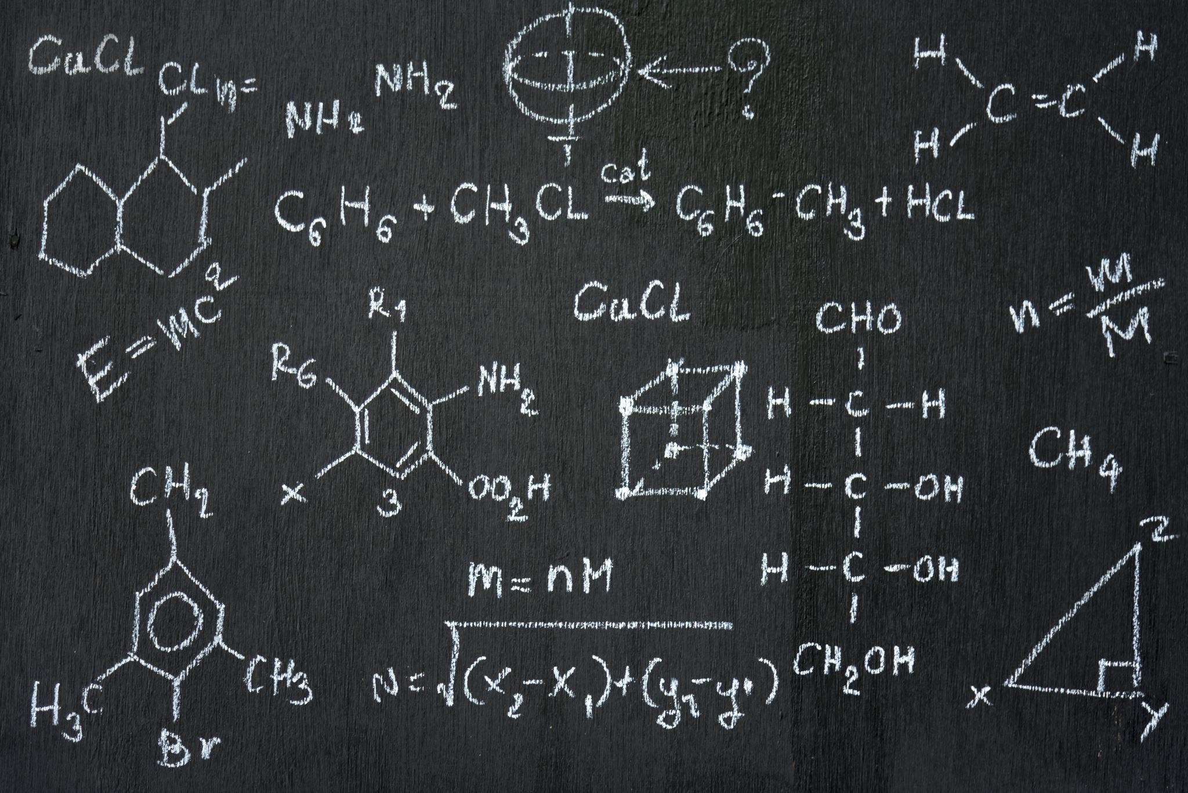
Generating new variable from existing variable
You can also use mathematical operations to create variables:
Example: generate bmi= weight / (height^2)
You can also use conditional logic
Example: generate agegroup = 1 if age<20

Slide 8
Replacing text in a string variable
Purpose: Replaces specific text within a string variable.
Command: replace
Example: replace sex=“F” if sex==“Female”
This is the simplest way to replace text in a variable

Slide 9
Replacing text in a string variable
Purpose: Replaces specific text within a string variable.
Command: replace
Example: replace string_var =subinstr(string_var, “old_text”, “new_text”, .)
We use “.” to replace all occurrences. You can use a number to replace specific instance
Example: replace sex = subinstr (sex, “female”, ”F”,.) will replace all text “female” into “F” in the variable sex

Slide 10
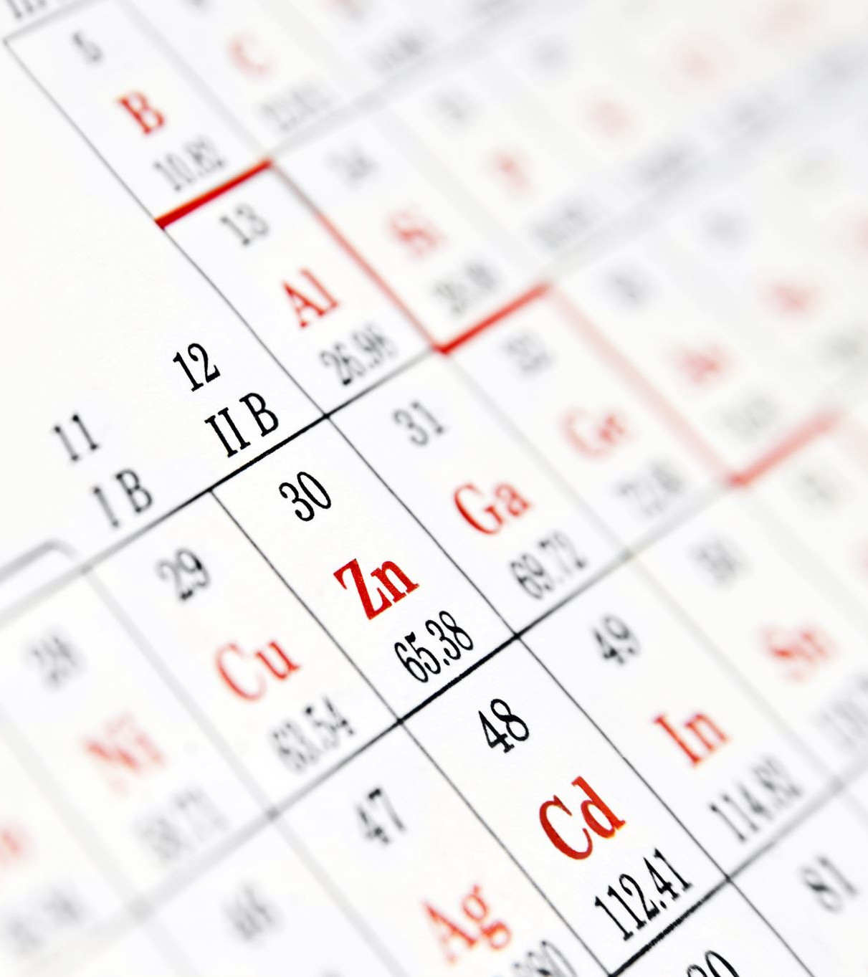
How to customize display format of a variable
Purpose: Controls how numeric or date variables are displayed (e.g., decimal places, width).
Command: format
Example: format income %10.2f

Slide 11

NUMERICAL VARIABLES

Slide 12
Checking data quality-identifying missing
Count
Count missing values: count if missing(hba1c)
Summarize
Summarize missing values: misstable summarize hba1c
Tabulate
Tabulate variable to show missing
tab hba1c, missing

Slide 13
Checking data range and Visualizing outliers
Validate plausible ranges: summarize sbp (check min and max)
Flag implausible values: gen flag = (sbp < 50 | sbp > 200)
(| stands for “or”, you can use “&” for and)
Visualize outliers: graph box sbp

Slide 14

Summarizing data and checking distribution
Basic summary: summarize hba1c
Detailed statistics:
summarize hba1c, detail
tabstat hba1c, stats(mean sd min max p50)
Check distribution: histogram hba1c
histogram hba1c, norm (this will show if variable conforms to normal distribution)

Slide 15
Dealing with errors and missing values
Correcting errors:
Replace incorrect values: replace hba1c = “0” if hba1c ==“O”
Drop implausible values/outliers: drop if hba1c < 0
Imputing missing values:
Mean imputation:
summarize hba1c, det replace hba1c = r(mean) if missing(hba1c)
Advanced imputation: Use mi or ice commands.

Slide 16
DATES
Date is a special type of numerical data
Stata stores dates as numeric values (number of days since January 1, 1960)
Use format to display dates in a readable format (e.g., %td for daily dates, %tm for monthly dates and %ty for yearly dates)

Slide 17
Common date commands
Convert
Convert string to date: gen dob= date(birthdate, "YMD") (Replace "YMD" with the format of your string, e.g., "DMY").
Extract
Extract components: gen birthyear = year(dob) gen birthmonth = month(dob) gen birthday = day(dob)
Create
Create date variables: gen intervention_date= mdy(12, 31, 2023)

Slide 18
Date calculations
Calculate differences: gen days_diff = date2 - date1
Add/subtract days: gen new_date = date_var + 30

Slide 19

Formatting dates
Apply formats: format date_var %tdNN/DD/YYYY
NN/DD/YYY will change based on how you want your dates to be displayed
In the above format, date will be displayed as month/day/year
NOTE:
Always check for missing values (mvdecode)
Use list to verify date transformations
Example
gen admission_date = ymd(2023,10,15") format admission_date %tdNN/DD/YYYY list admission_date

